Slide 1
The Future of Blockchain
By Paras Dalal

Slide 2
What Do I Plan to Cover
Problems that we want to solve
General concept of Blockchain
Overview of How it is implemented
Common uses of Blockchain
Problems of Blockchain
Is it relevant to Bessemer?

Slide 3
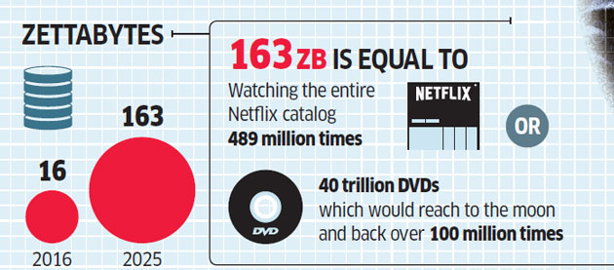
Problems that we want to solve
Data Overflow
1,000,000,000,000,000,000,000 (10²¹ = 1 Billion Terabytes)

Slide 4

Problems that we want to solve
Data Security

Slide 5
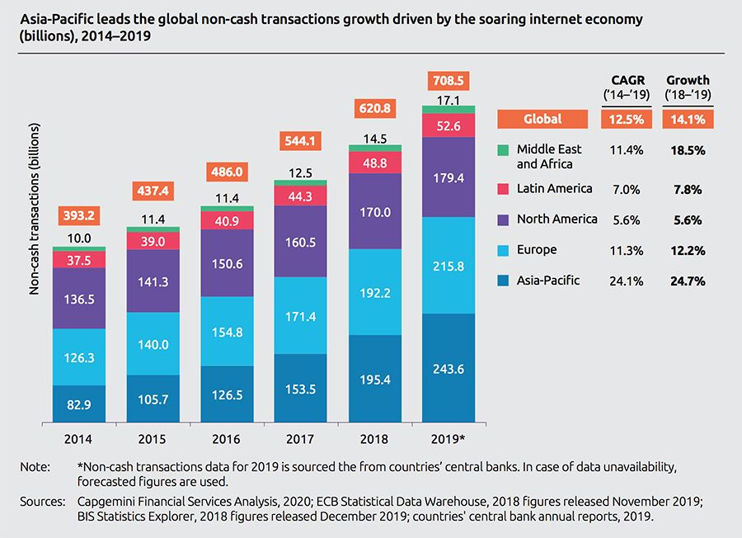
Problems that we want to solve
Transactions

Slide 6
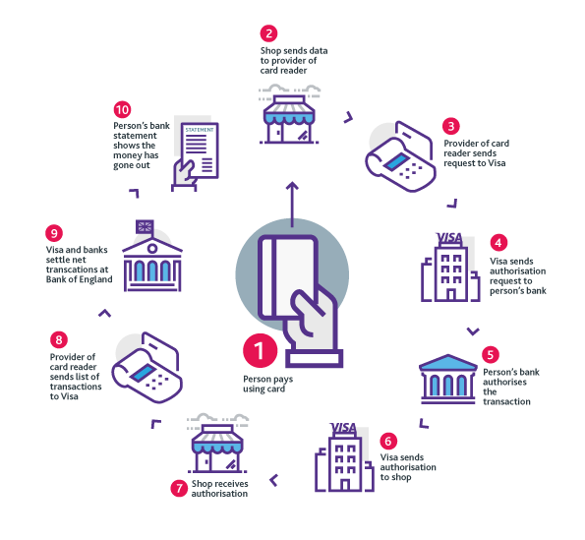
Problems that we want to solve
Intermediaries

Slide 7
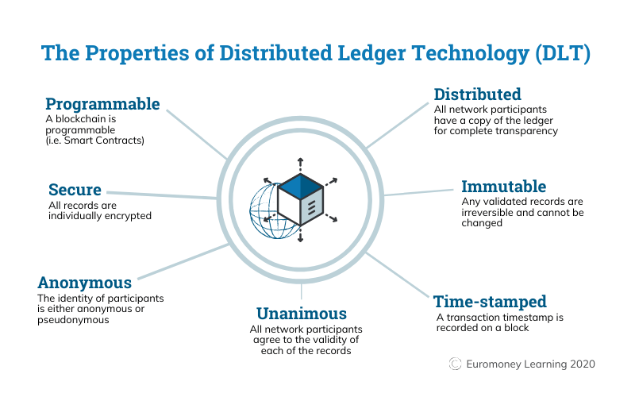
General concept of Blockchain
Blockchain is a type of Distributed Ledger Technology

Slide 8
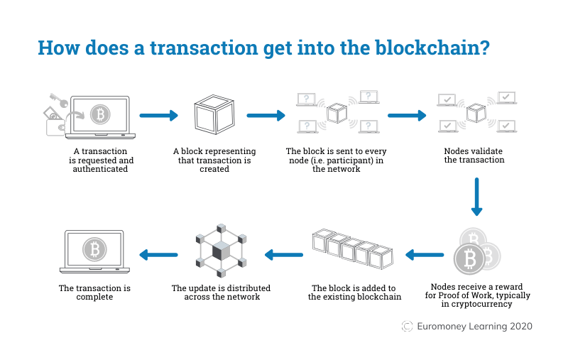
Overview of How it is implemented

Slide 9
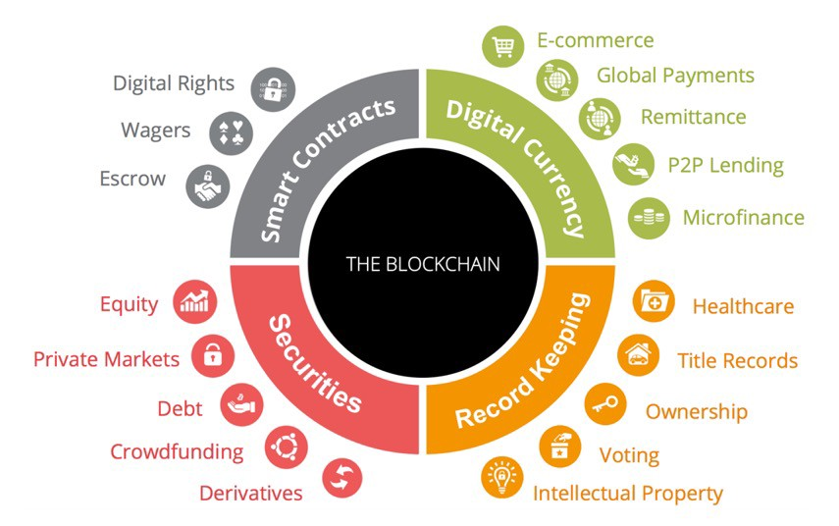
Common uses of Blockchain

Slide 10
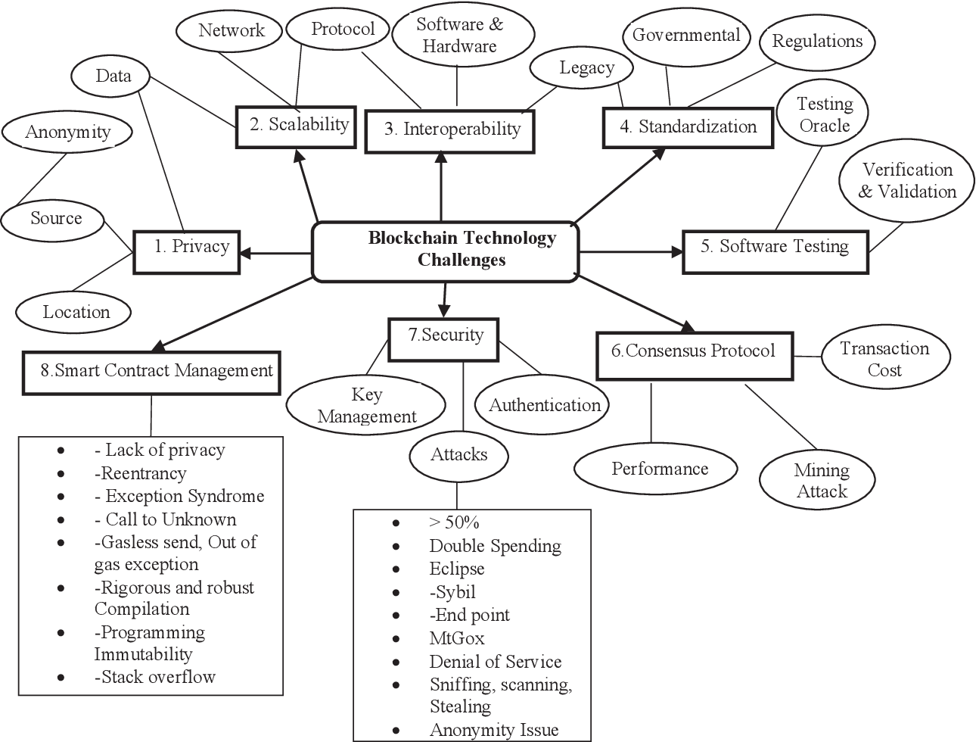
Problems of Blockchain

Slide 11
Is it relevant to Bessemer?

